Slide 1

Smart Device Trends and Marketing Influence
Presented By: Kevin Larkin
Last Updated: December 14th, 2021

Slide 2
Table of Contents
Objective
Data Description
Activity
Sleep
Intensity
Summary and Recommendations

Slide 3

Objective

Slide 4
Objective
Identify trends in smart device usage, how these trends apply to Bellabeat customers, and how these insights can help guide Bellabeat’s marketing strategy.
For this analysis, I will be focusing on the Leaf tracker, which can be worn as a bracelet, necklace, or clip to track activity, sleep, and stress.

Slide 5

Data Description

Slide 6
Data Description
The data is a collection of personal Fitbit tracker data from thirty users.
Unfortunately, there’s no indication of users’ sex
The three datasets used contained information on users’ activity, sleep, and intensity levels (or how much energy was expended during exercise) every day for a month.
Some metrics included steps taken, distance traveled, total minutes asleep, and total intensity.

Slide 7
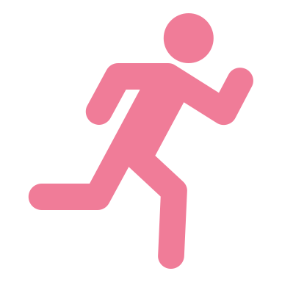
Activity

Slide 8
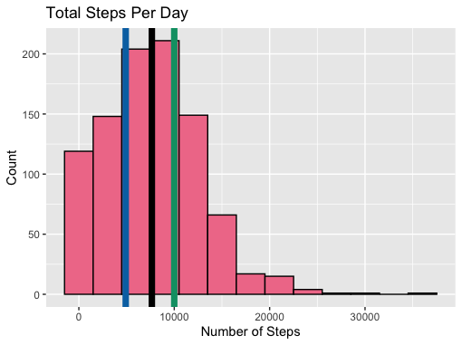
Total Steps
Adult females in the US take about 4,912 steps per day, indicated by the blue line.
Fitbit users take about 7,654 steps per day, indicated by the black line.
Healthy individuals are recommended to take about 10,000 steps per day, indicated by the green line.
These users are more active than the average woman, but not as active as recommended by medical professionals.

Slide 9
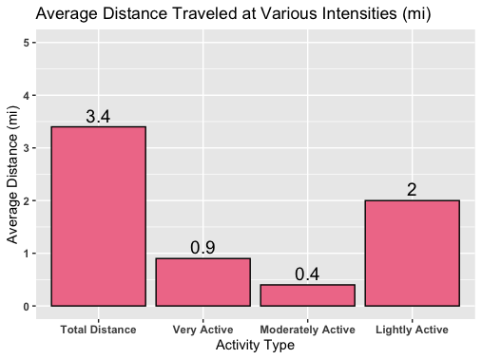
Average Distance
Unsure exactly what defines intensity levels, but it’s most likely based on many factors such as weight, sex, and age and defined differently for everyone.
Average total distance traveled each day was 3.7 miles.
Average distance traveled at a very active intensity was 0.9 miles.
Average distance traveled at a moderately active intensity was 0.4 miles.
Average distance traveled at a lightly active intensity was 2 miles.
Medical professionals recommend walking 5 miles per day for general health.

Slide 10
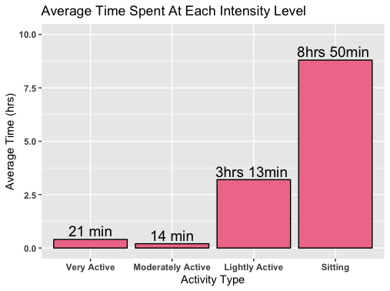
Average Time
Average time spent at a very active intensity was 21 minutes.
Average time spent at a moderately active intensity was 14 minutes.
Average time spent at a lightly active intensity was 3 hours and 13 minutes.
Sitting average was originally 16 hours and 30 minutes, but this includes time in bed and sleeping.
Average time spent sitting was 8 hours and 50 minutes.
These users spend most of their waking day sitting, most likely working.

Slide 11
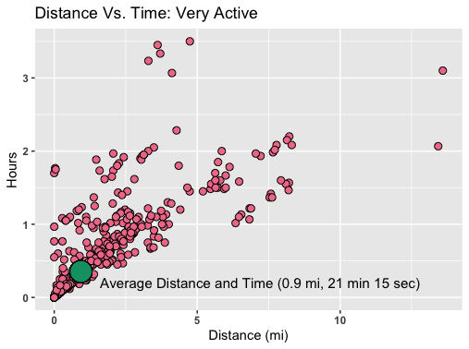
Distance Vs. Time: Very Active
Majority of the time spent was below 1 and a half hours and less than 5 miles at a time.
The intersection of the average distance and time spent at a very active intensity is highlighted by the green dot, being 0.9 miles and 21 minutes 15 seconds.
This would be equivalent to about a 23 minute and 37 second mile pace.

Slide 12
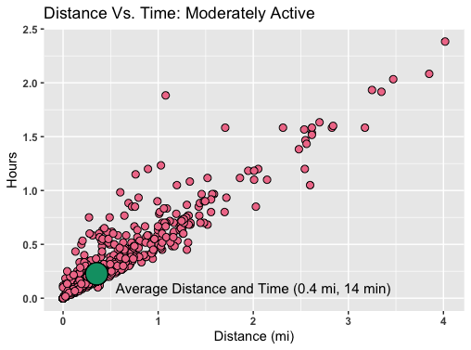
Distance Vs. Time: Moderately Active
Majority of the time spent was below 1 hour and 15 minutes and less than 2 miles at a time.
The intersection of the average distance and time spent at a moderately active intensity is highlighted by the green dot, being 0.4 miles and 14 minutes.
This would be equivalent to about a 35-minute mile pace.

Slide 13
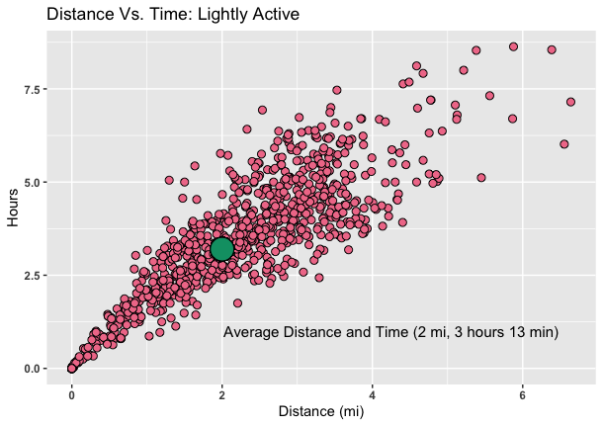
Distance Vs. Time: Lightly Active
Majority of the time spent was below 7 hour and a half hours and less than 4.25 miles at a time
The intersection of the average distance and time spent at a lightly active intensity is highlighted by the green dot, being 2 miles and 3 hours 13 minutes.
This would be equivalent to about a 1 hour, 36 minute and 30 second mile pace.
Many more records of lightly active than other intensities.
More spread out indicates lightly active aren’t planned distances, which may be the case for other intensities.
Although intensity based on many factors, mile pace indicates individuals aren’t highly active.

Slide 14
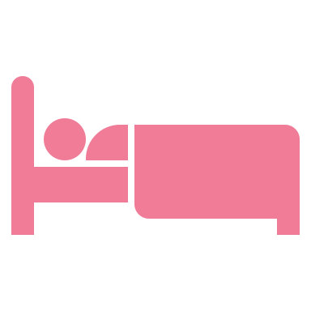
Sleep

Slide 15
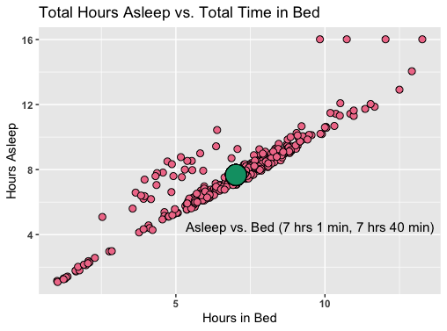
Time Asleep Vs. Time in Bed
As expected, the average time spent in bed and asleep are very similar.
The average time spent in bed was 7 hours and 40 minutes and the average time spent asleep was 7 hours and 1 minute.
According to the CDC, adults should aim for at least 7 hours of sleep per night.
The extra time spent in bed not sleeping could possibly be due to stress, restlessness, or time spent reading / on phone. More research required.

Slide 16
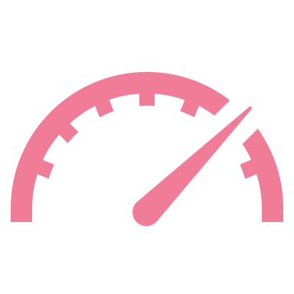
Intensity

Slide 17
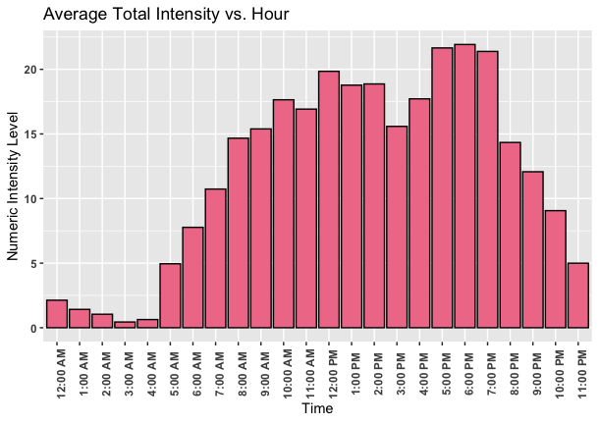
Average Total Intensity Vs. Hour
Sedentary = 0, Light = 1, Moderate = 2, Very Active = 3.
Each minute is given one of these values, and total intensity is the sum of these 60 values for that hour.
Lowest average intensity was at 3AM and highest was at 6PM.
Average intensity per hour was 12.
Lowest was most likely due to sleeping and highest due to people working out after work.
According to professionals, exercising 90 minutes or longer before bedtime should have no negative affect on your sleep.

Slide 18

Summary and Recommendations

Slide 19
Summary and Findings
Fitbit users are more active than the average American, but not super active.
Most likely people with office day jobs, as they sit for most of the day and exercise around 6/7PM, when most people get home from 9-5 jobs.
May have trouble falling asleep, which could be due to work/life stress, exercising too close to bedtime, or reading/cell phone use in bed.

Slide 20
How Findings Can Influence Marketing Strategy
Target people with jobs that require a lot of sitting by marketing the Leaf to promote more physical activity throughout the day.
Advertise features that promote better sleep such as reminders to complete certain amount of activity before bedtime and to turn off electronics before getting into bed.
Increase advertising efforts in gyms and fitness centers during evenings.

Slide 21

Thank you! Questions?

Slide 22
Appendix
Bellabeat Study Rubric: Follow this link
Changelog: Bellabeat Case Study Changelog
Datasets Used: Kaggle page with datasets
Sources:
Average steps per day: Mayoclinic, Medical News Today
Average mile time: Medical News Today
Amount of sleep per night for adults: CDC
Good exercise time prior to sleep: Sleep.org

